Slide 1
ASP.NET
Configuration

Slide 2
Configuration
1
Introduction

Slide 3
About configuration
All applications have configuration data
Configuration file
Hard coded ☹
With configuration, you make your application more reusable
No more app.config or web.config
Much more simplified in core
In .net core
Work with key value pairs

Slide 4
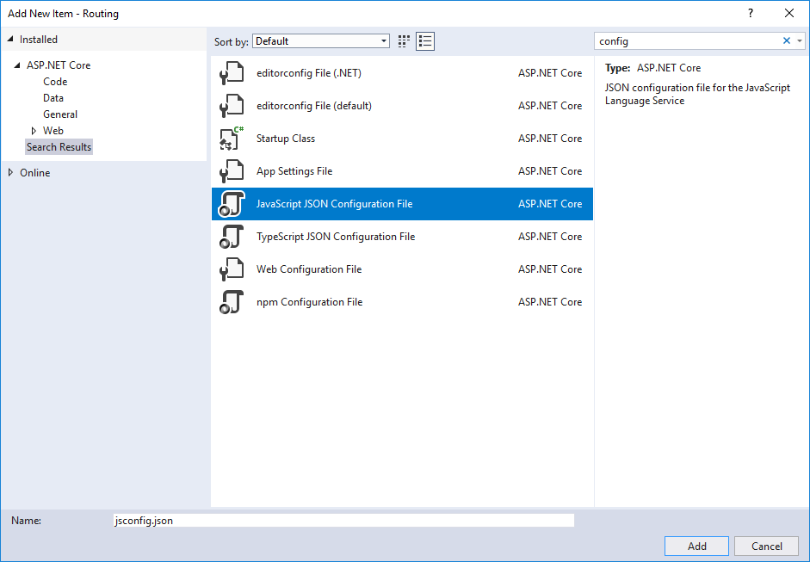
Basic configuration

Slide 5
Basic Configuration
{
"foo": "value of foo",
"bar": "value of bar"
}

Slide 6
Basic Configuration
public void ConfigureServices(IServiceCollection services)
{
services.AddMvc(o =>
{
o.Conventions.Add(new ElmosApiControllerConvention());
});
var bobTheConfigbuilder = new ConfigurationBuilder()
.SetBasePath(Directory.GetCurrentDirectory())
.AddJsonFile("elmosConfig.json");
Configuration = bobTheConfigbuilder.Build();
}

Slide 7
Configuration Providers
Configuration can be loaded from many different sources
Configuration providers are responsible for passing the configuration in a specific format
JSON
XML

